Slide 1
SI_507 Unit Testing
Hopefully, you’ve already been testing your code by checking output to expected output
typically with print statements
cumbersome
does not scale
Unit Test are automated Testing
import unittest
make a subclass of unittest.TestCase
define methods for test cases
start each method with test_
use assertion methods to check the results
run the tests using unittest.main

Slide 2
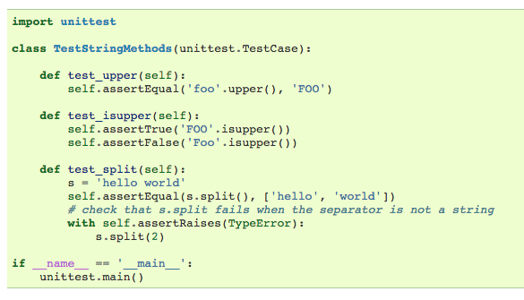
Other Assertion Methods
assertTrue
assertFalse
assertRaises
See https://docs.python.org/2/library/unittest.html for more information

Slide 3
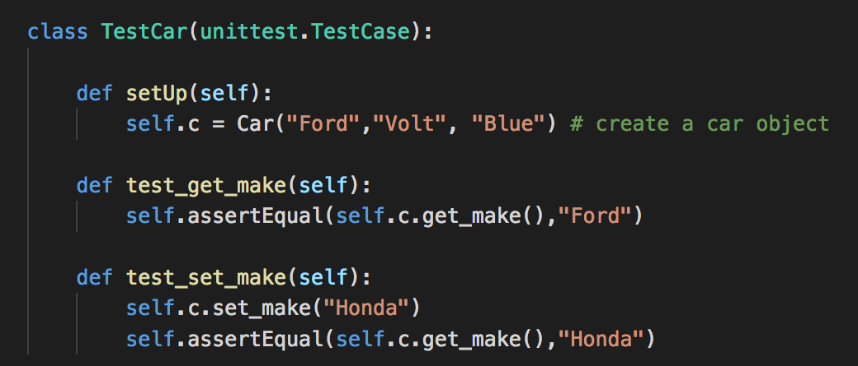
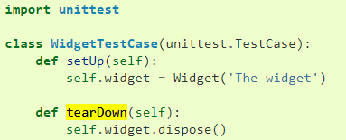
Set up and tear down methods
Tests are run in order by the function names – not the order they are defined
setUp is run before every test method
tearDown is run after every test method
Notes:
See car5.py

Slide 4
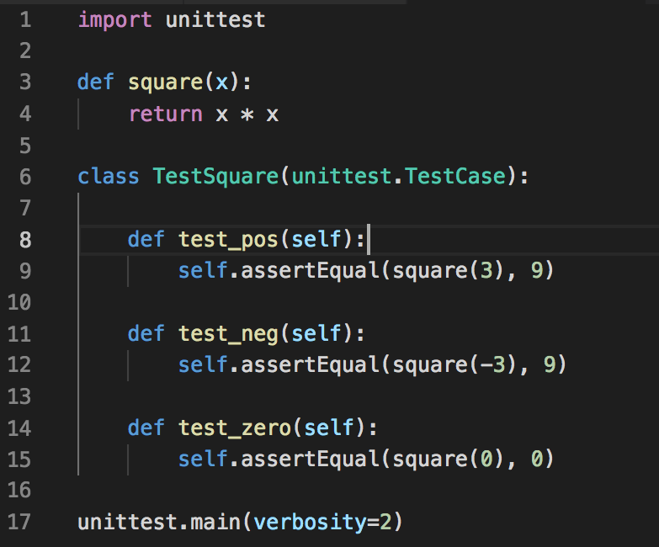
Testing Edge Cases
Test usual values
Test edge cases
Negative
Very Small
Very Big
Zero

Slide 5
cards.py Examples
read the docstring to understand how the code works
instance attributes section
’’’
suit: int
the numerical index into the suit_names list
suit_name: string
the name of the card's suit
rank: int
the numerical rank of the card
rank_name: string
the name of the card's rank (e.g., "King" or "3")
’’’
How can we test?
c1 = Card(0, 3) # 3 of diamonds
c2 = Card(1, 1) # Ace of clubs
c3 = Card(2, 12) # Queen of hearts
print (c1)
print (c2)
print (c3)

Slide 6
cards_test.py example
cards_test.py imports unittest. This is built into the Python default library.
cards_test.py imports cards, which is the module being tested.
the code defines a class TestCard (which is a subclass of unittest.TestCase)
the TestCard class has one method, called test_construct_Card(), which creates some objects using the cards module and then declares a bunch of assertions that test to make sure that various aspects of the created objects are what they are supposed to be.
cards_test.py uses if __name__=="__main__": to make sure that the test code only runs when cards_test.py is the main Python file.
inside the if __name__=="__main__": conditional, the code calls unittest.main()--this is what causes all of the tests to run

